Slide 1
Emmy Saenz foundation
Emmy Saenz Foundation
2001 E. Sabine St, Suite 108
Victoria, TX 77901
361-894-3998
Emmysaenzfoundation@outlook.com
WWW.EMMYSAENZFOUNDATION.ORG
EIN 86-1552435
2024 Sponsorship Program

Slide 2
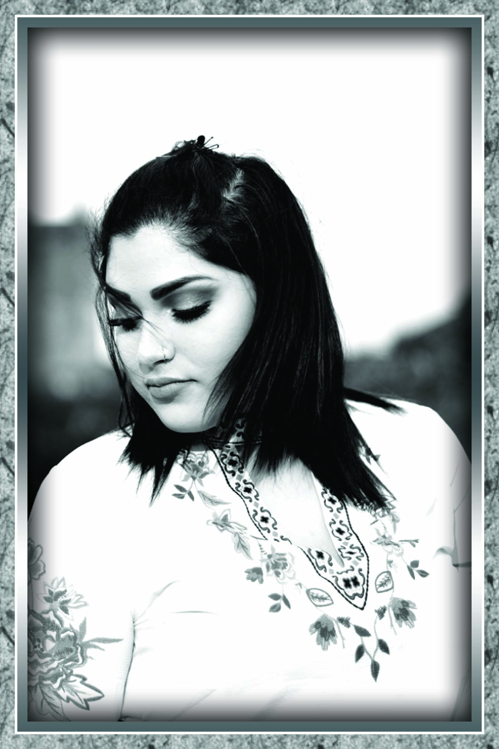
EMMY SAENZ FOUNDATION
Emmy Saenz is the daughter of Luis Saenz and Rosemary (Michael) Bazan. She sustained cervical, thoracic and lumbar fractures of her spine in a major motor vehicle collision on Hwy 35 (Formosa Gate 6) on October 1, 2019. Emmy became paralyzed as a result of the auto-accident and lived her remaining 7 months as a quadriplegic. Because the family had to overcome so many obstacles in caring for Emmy, huge difficulties became everyday reality of how much outside help is needed to overcome just to have a good quality of life. In Emmy's precious memory, the Bazan family, with the help of family and friends, created a 501(c)(3) Non-Profit organization to help others in need in situations like these.
At the Emmy Saenz Foundation, we’re raising funds and promoting initiatives to serve the people who need them most. We believe in taking-action with urgency in order to serve our youth, community and individuals with Spinal Cord Injury (SCI) and Traumatic Brain Injury (TBI) in some of the most pressing issues facing today’s society. Please join us by supporting our efforts to make a measurable difference in the lives of others. Your Sponsorship is key in continuing our efforts throughout the year.
Emilia "Emmy" Celine Saenz
04/30/1999 - 04/30/2020

Slide 3
Accomplishments as of august 2023
Has Awarded 7 Scholarships
Donated Durable Medical Equipment and Supplies to 28 recipients throughout the State of Texas as well as a Florida resident
Helped Organize and Volunteered with numerous local Benefits to defray medical cost
Donated to 2 Families that reached out for Assistance with Funeral Expenses whom their loved one specifically had TBI’s
Will be launching an Online Support Group for patients and their families that have SCI/TBI. The focus will be to How to better Improve the daily lives of those with disabilities, How to work through the Social Security, Disability System (SSI) and Medicare/Commercial Insurance to the Care and Equipment or Supplies needed as well as How to Navigate through when there is a shortage of supplies.

Slide 4
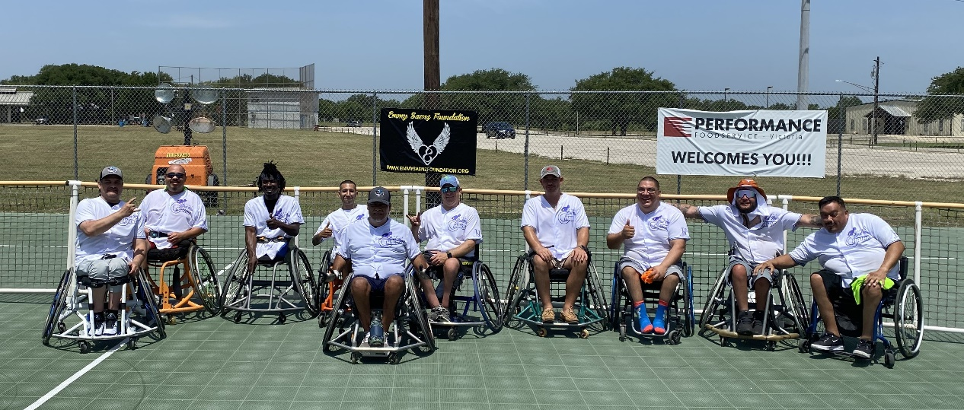
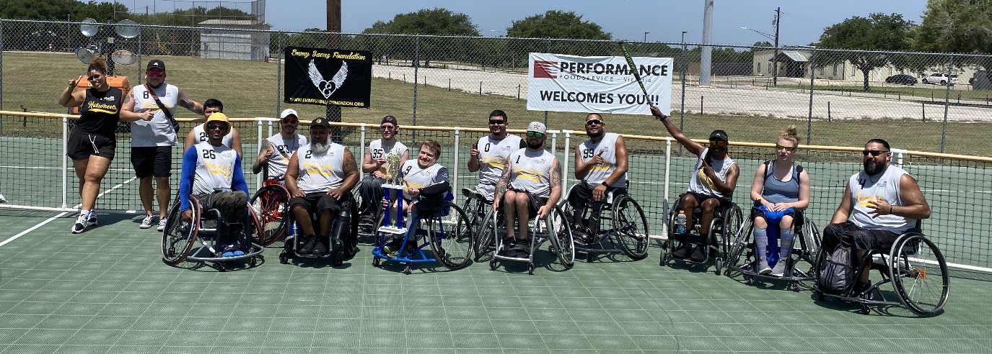
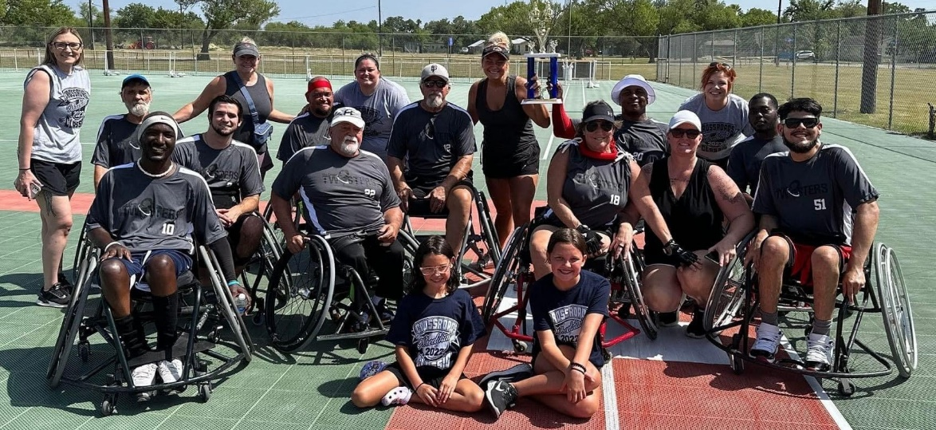
Proud Supporters of Adaptive Sports Teams both local and state-Wide

Slide 5
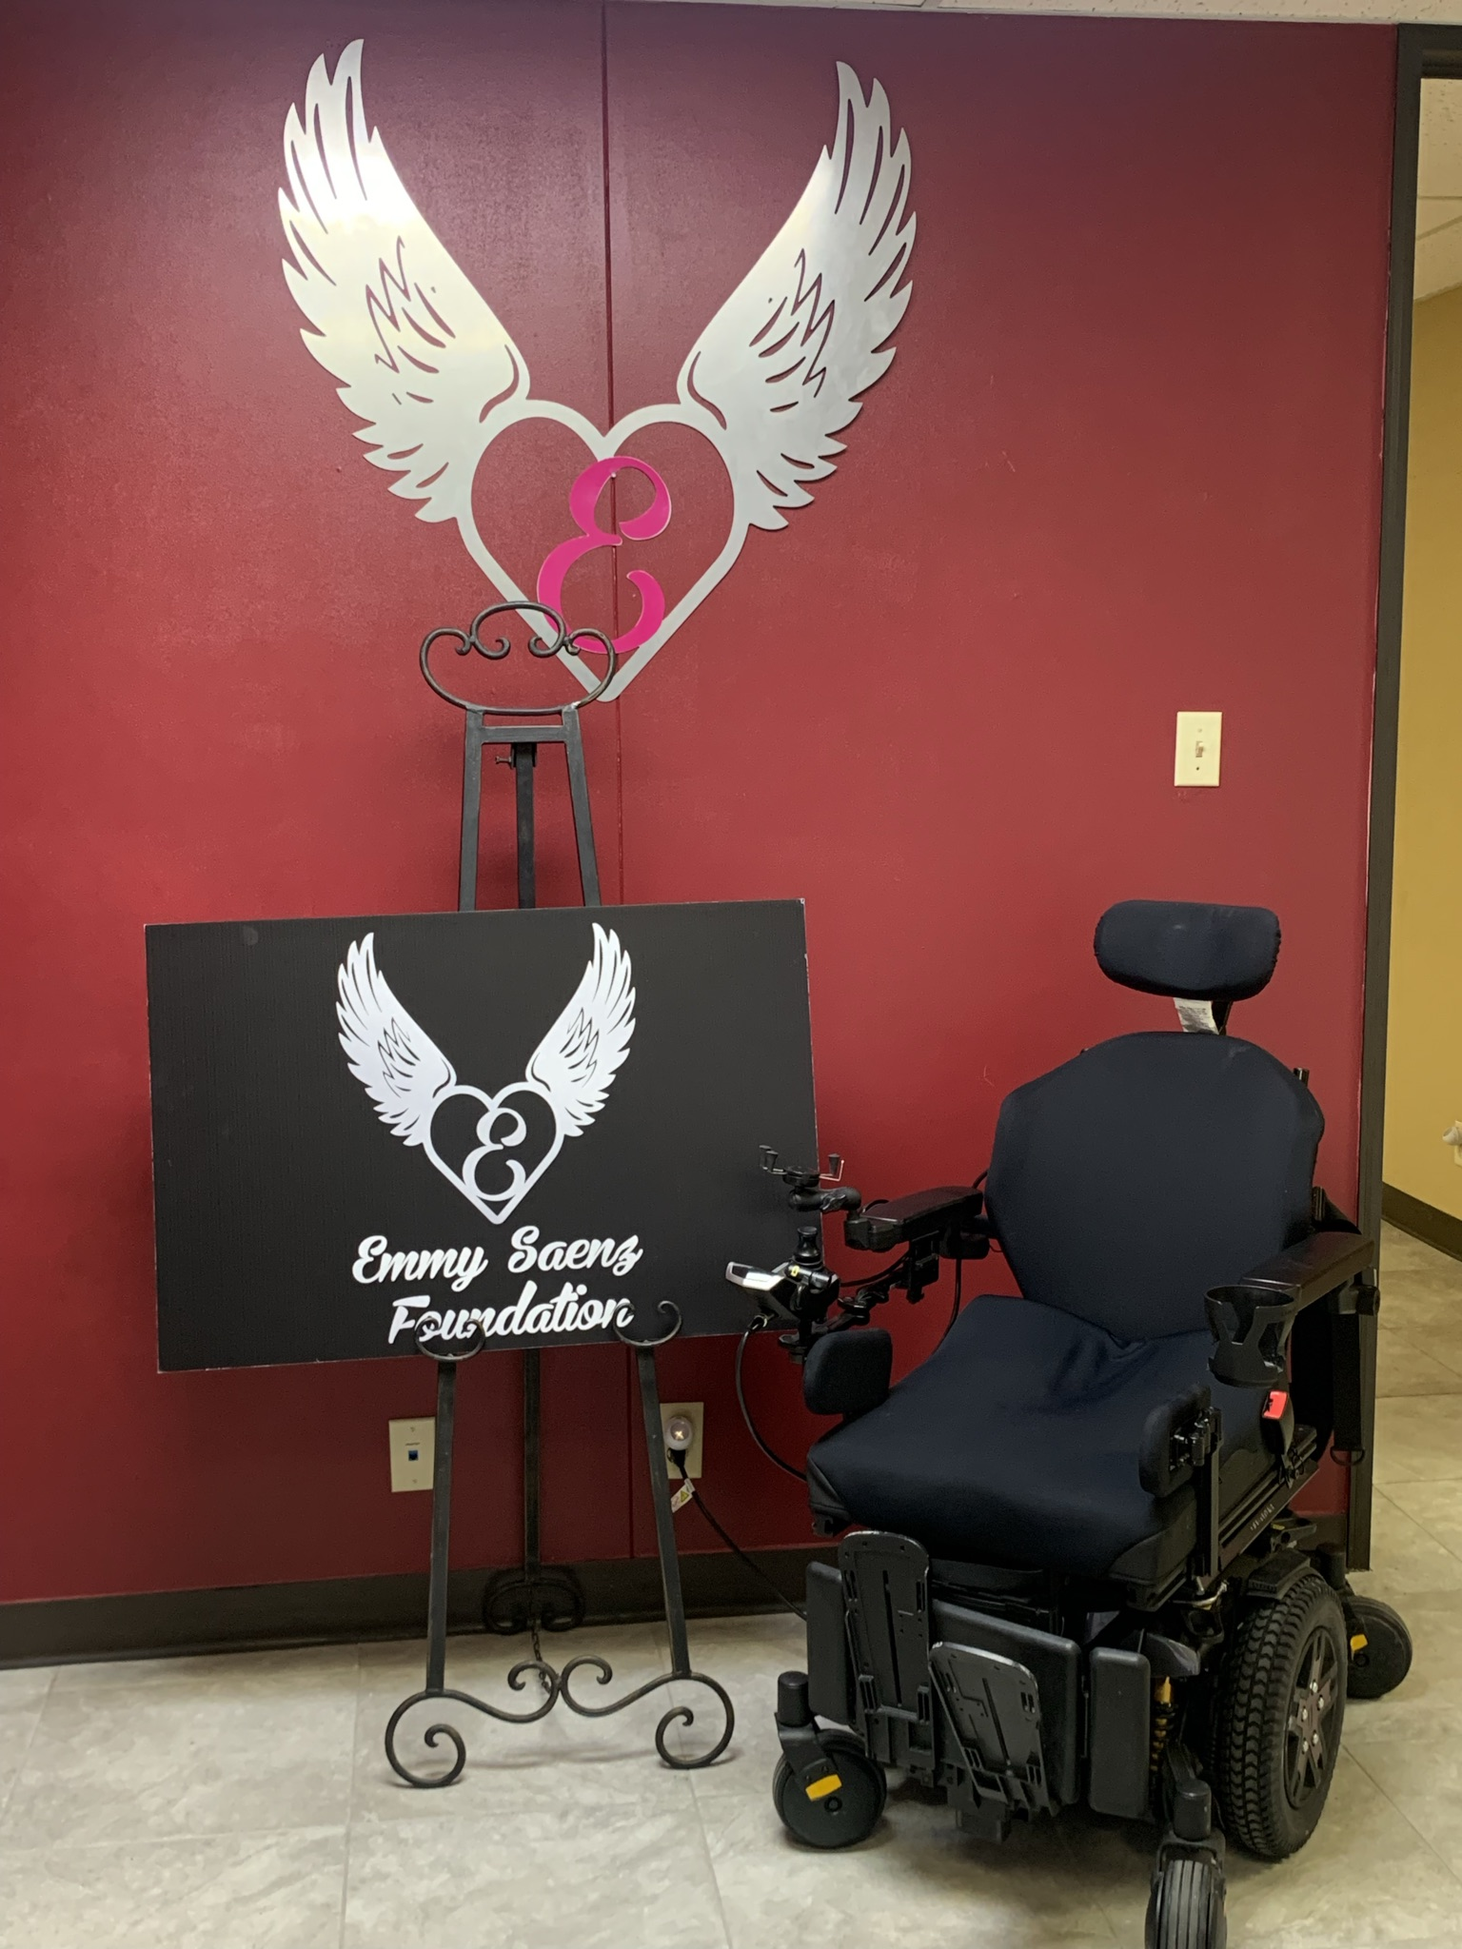
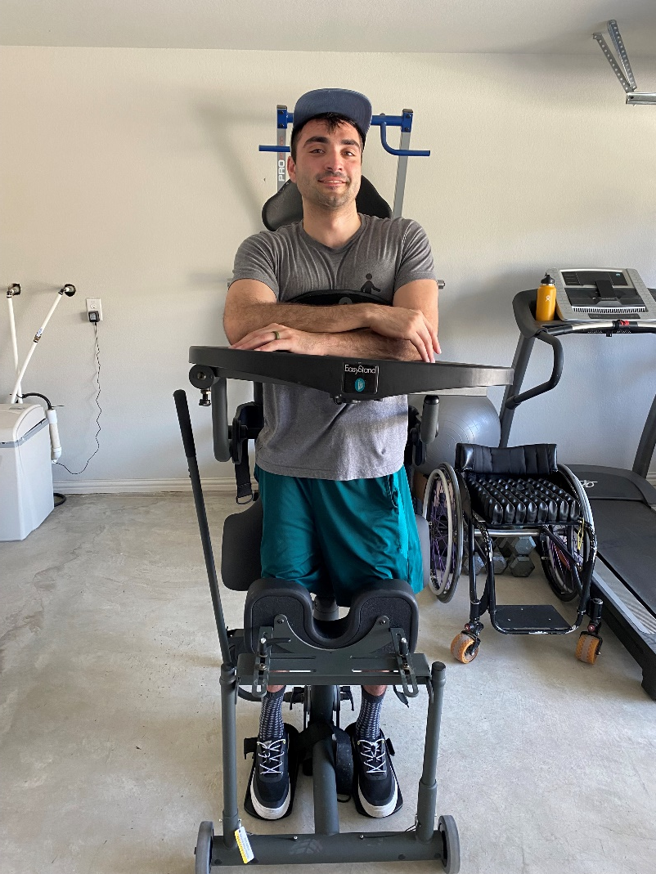
EMMY Saenz Foundation
SCI & TBI Community Initiate:
Our goal is to promote great opportunities for those in need who have suffered from Spinal Cord Injuries and or Traumatic Brain Injuries. With access to the right resources, people with SCI & TBI can become empowered by strengthening their own abilities and gain the confidence to fulfill their potential. Our mission is to help make available the resources needed to recover and rehabilitate with access to therapy, medical equipment and supplies. When families are struggling to get the most basic needs for daily care of their loved one, we are here to help close the gap in obtaining those resources.
Edward “Will” Willis (Kyle, TX) recipient of Durable Medical Equipment
Office of Emmy Saenz Foundation
2001 E. Sabine, Suite 108, Victoria, TX 77901

Slide 6
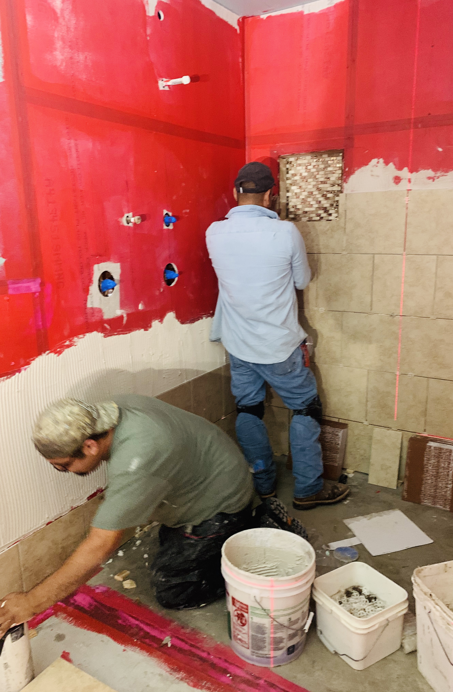
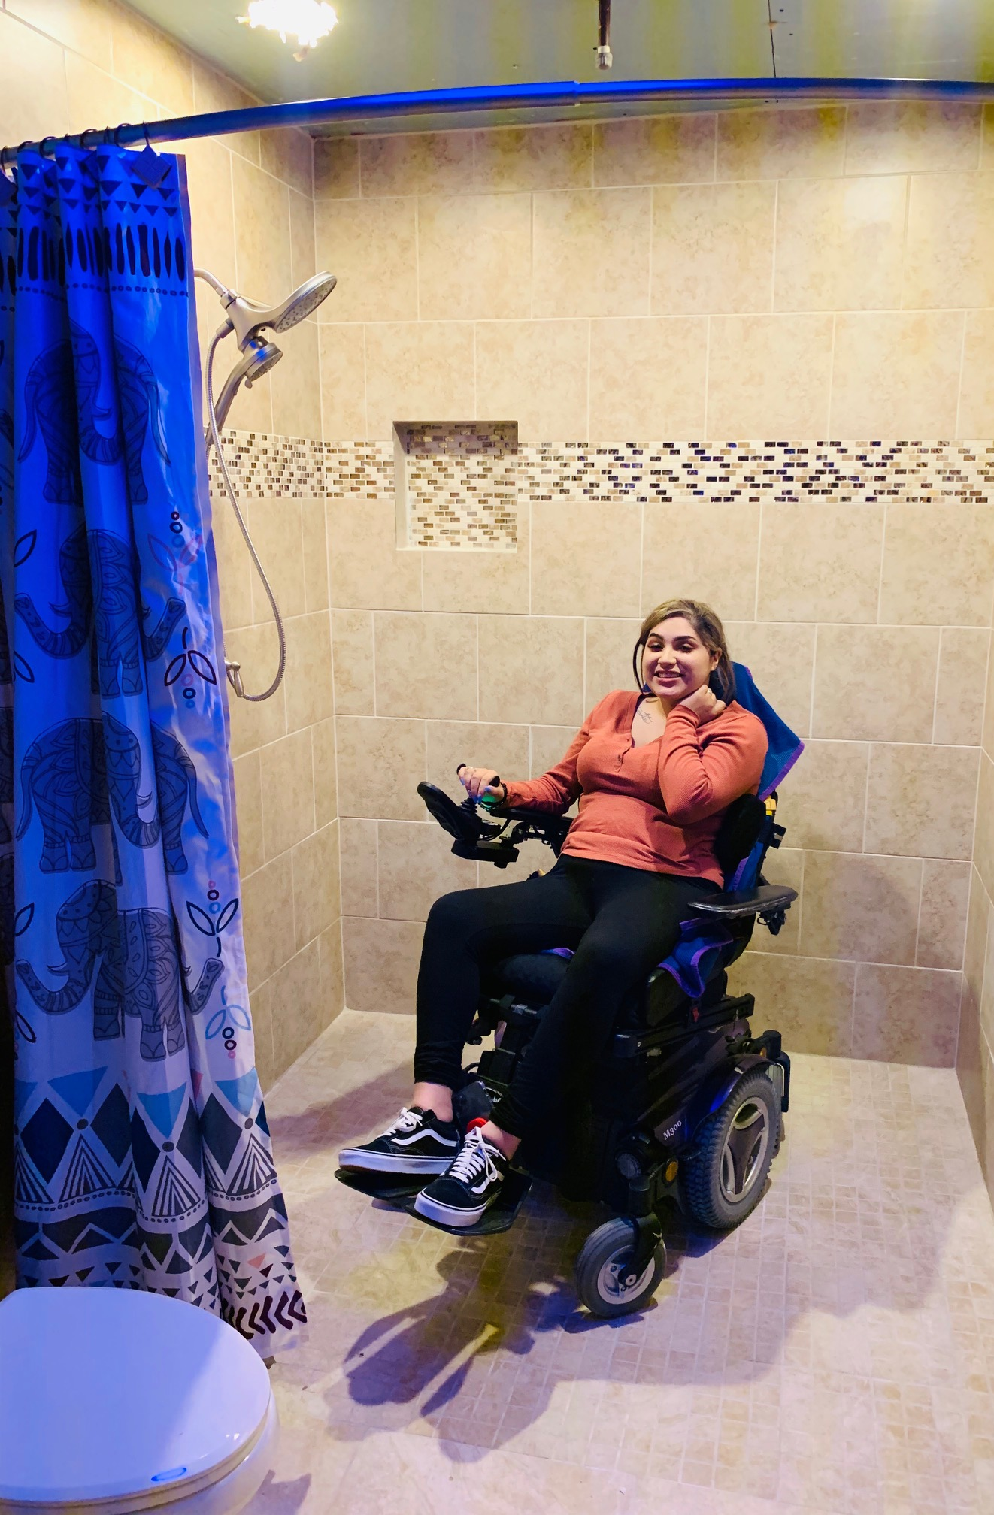
Emmy Saenz Foundation
ADA Home Modification Initiative: Our Home Modification initiative dedicated serving SCI and TBI patients with ADA compliant home modifications so they may be able to sustain a greater quality of life. Partnerships with local Contractors enables us to assist families with the cost of materials needed to add the appropriate modifications to their homes. Most contractors provide their labor free or discounted through our program so we can better serve our community.
All Mighty Plumbing (Edna, TX) donating labor and materials for bathroom remodel

Slide 7
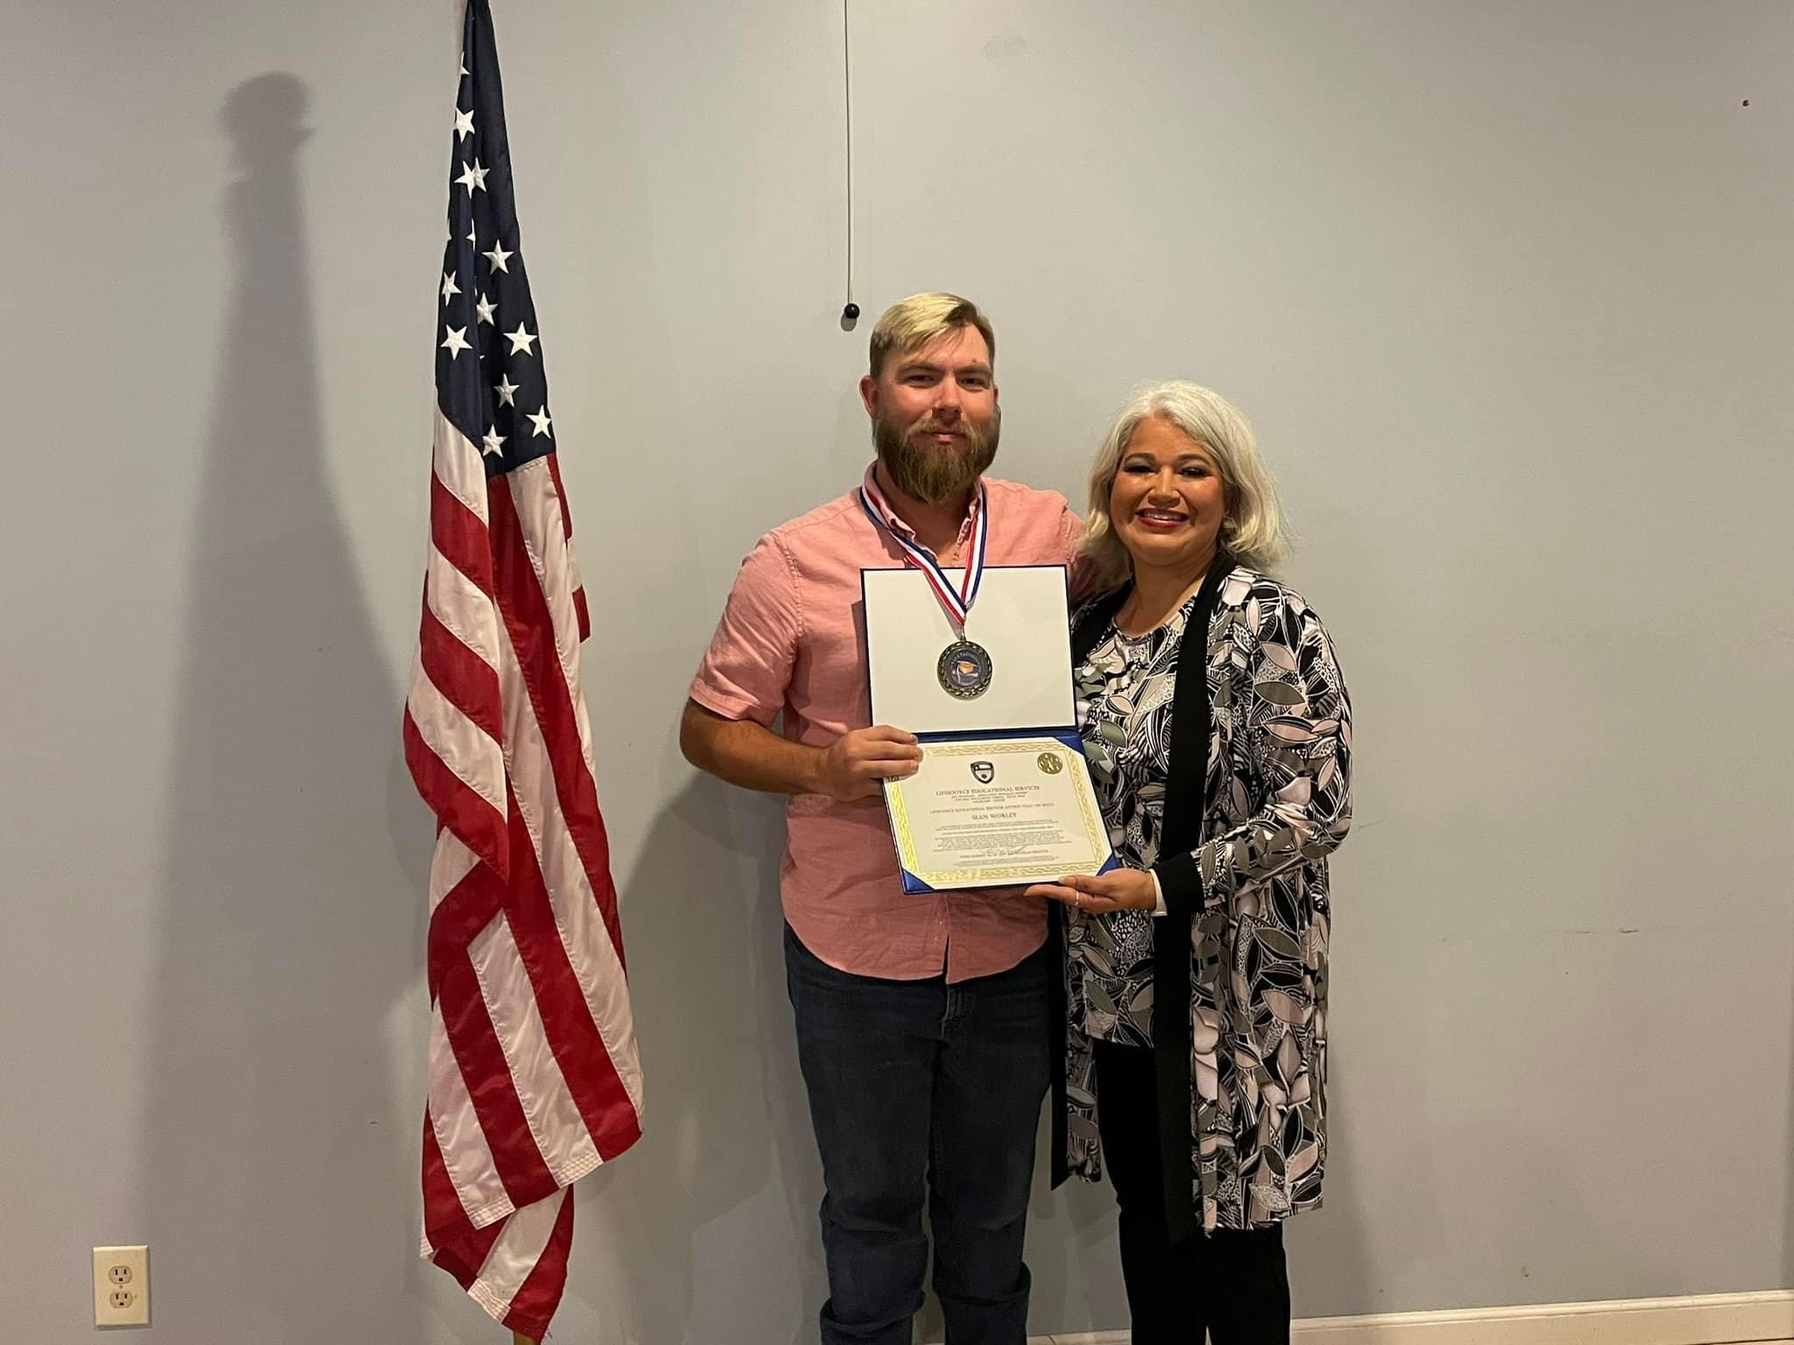
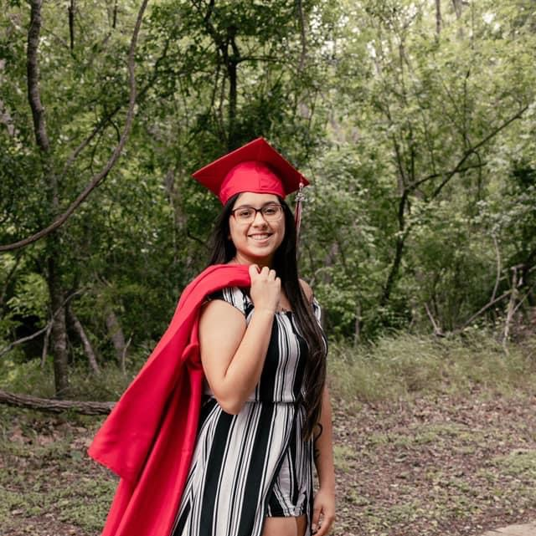
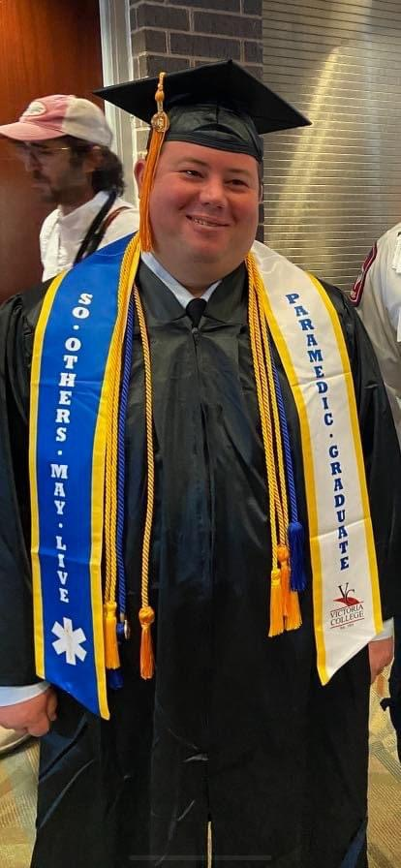
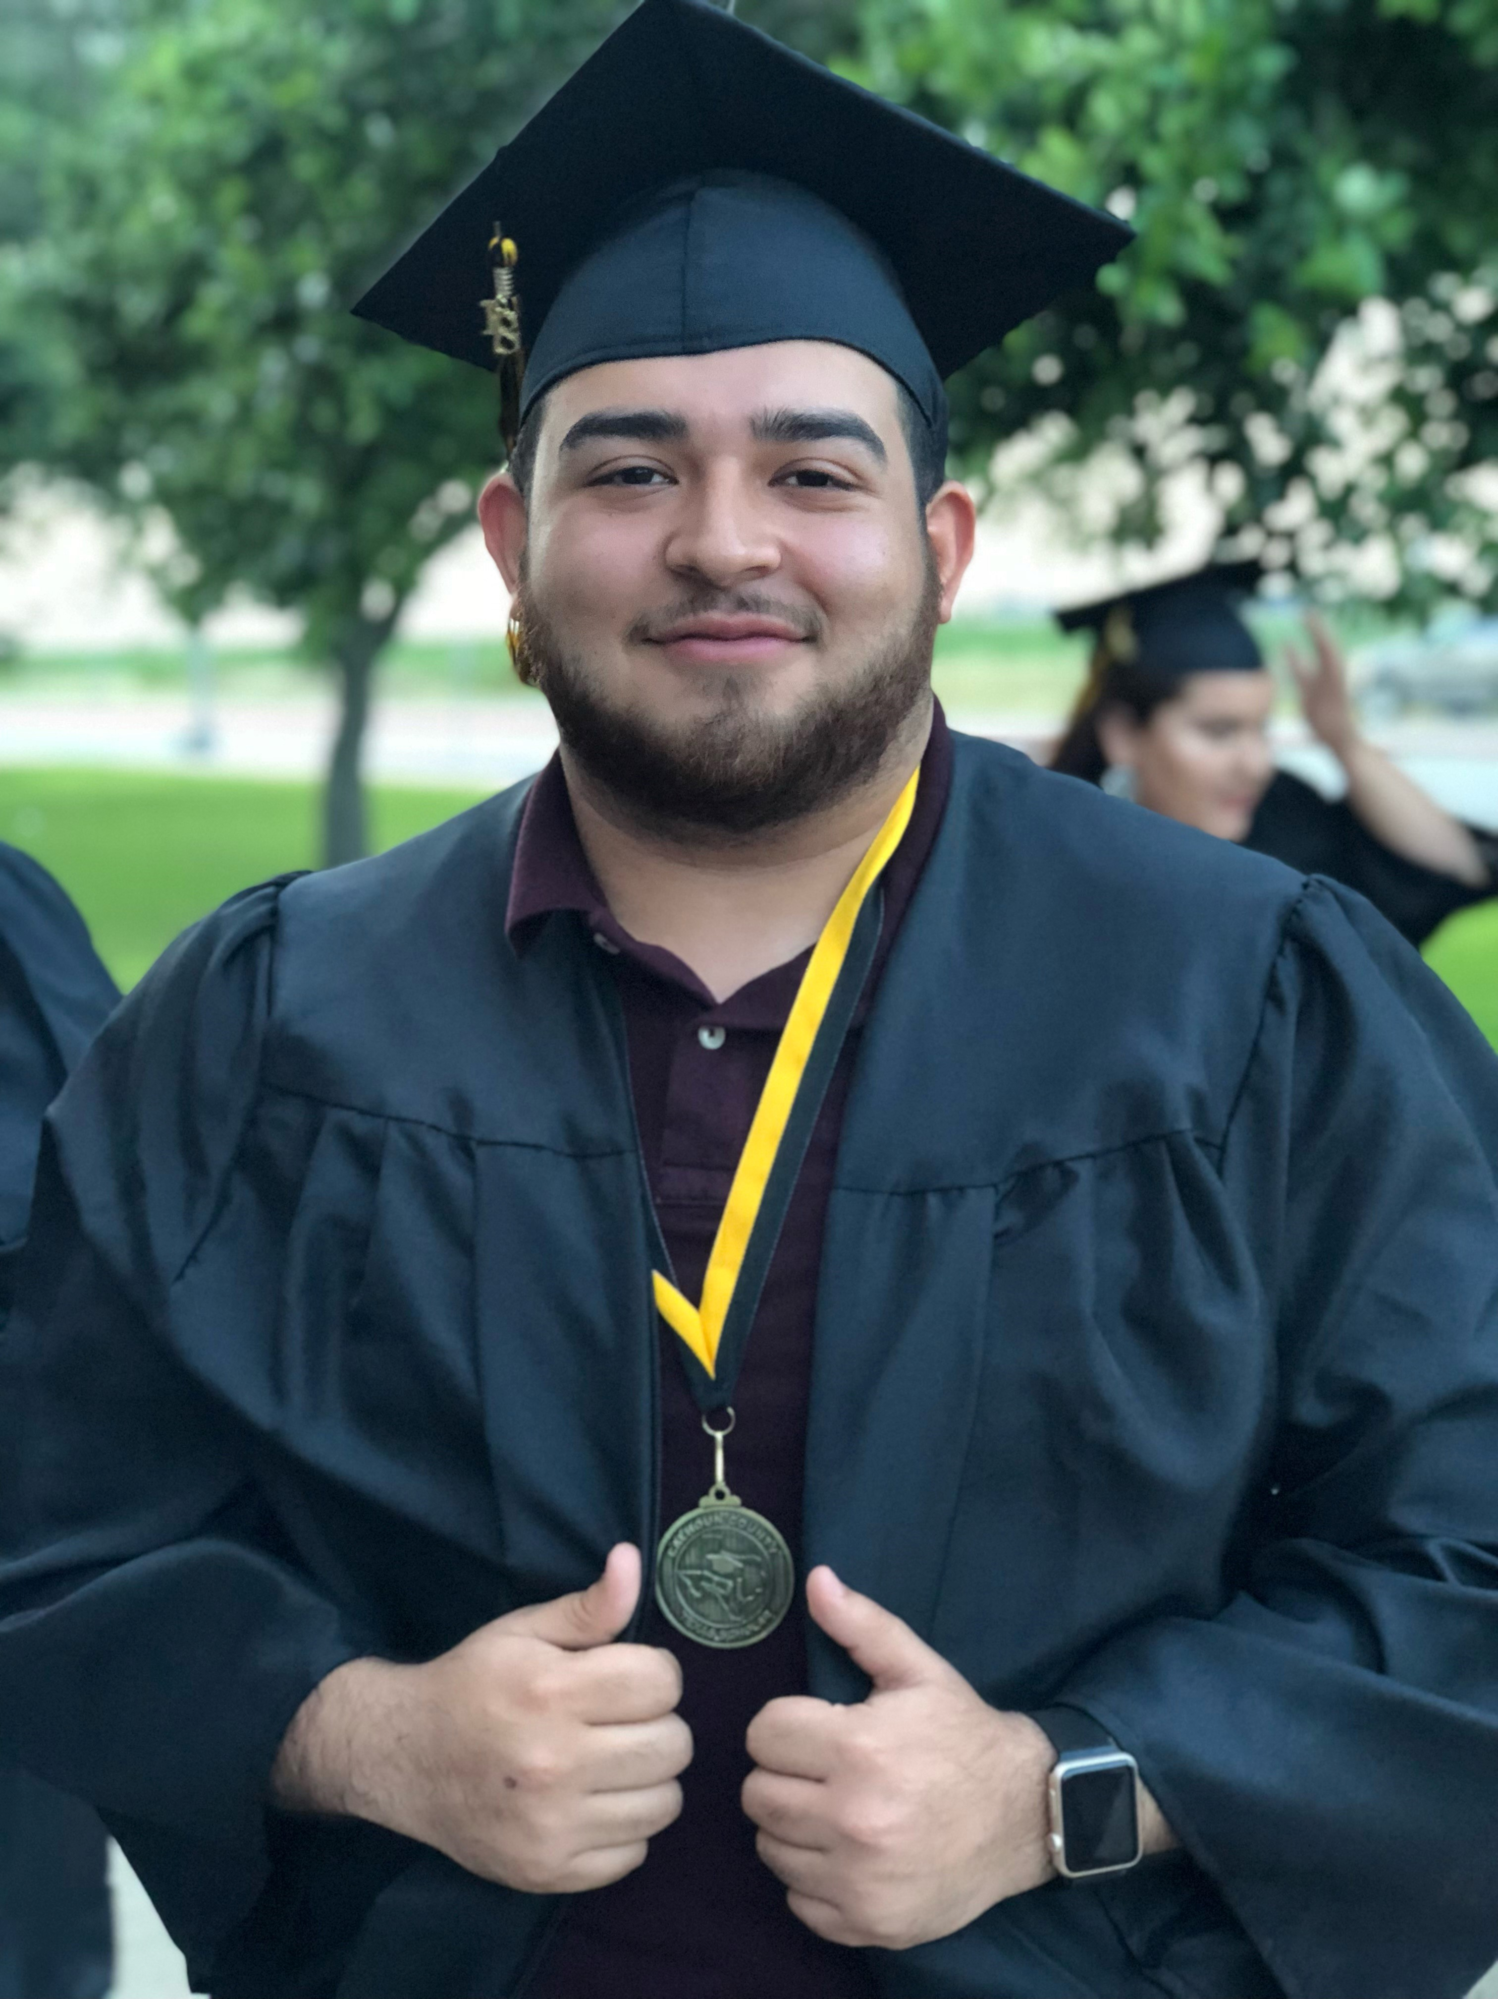
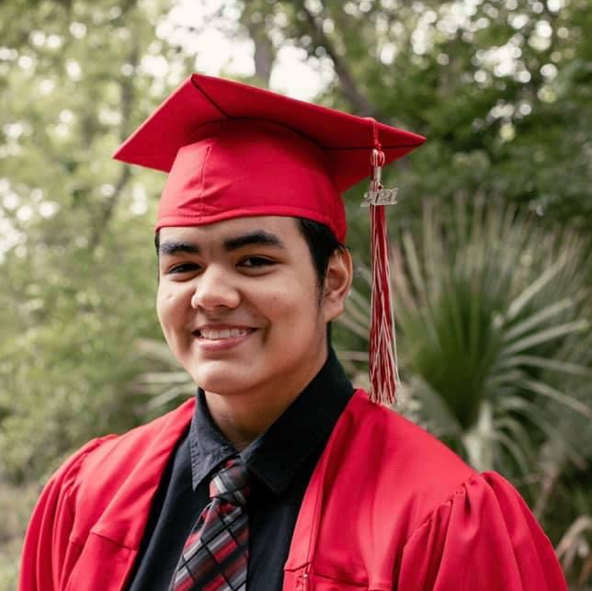
Emmy Saenz Foundation
SCHOLARSHIP PROGRAMS
With our organization’s mission always in mind, we strive to offer scholarships to students with a desire to pursue a career in Emergency Services as well as to students who successfully completed high school with learning disabilities and or physical disabilities. We believe that every student has what it takes to succeed in higher education to build a better and brighter future for themselves.
Like Emmy, many students are faced with the challenges of learning and/or physical challenges. Many times, offering an opportunity to attend a trade school rather than a college or university is key to developing careers with a hands-on learning environment. Though our commitment is not just focused on students with these challenges, we are also invested in helping those in financial need whom otherwise, would not pursue higher education. Because we believe in the importance of growing our healthcare and first responders' population, we are now offering scholarship opportunities in these fields of study as well as Teaching with a special focus in Special Education Services.

Slide 8
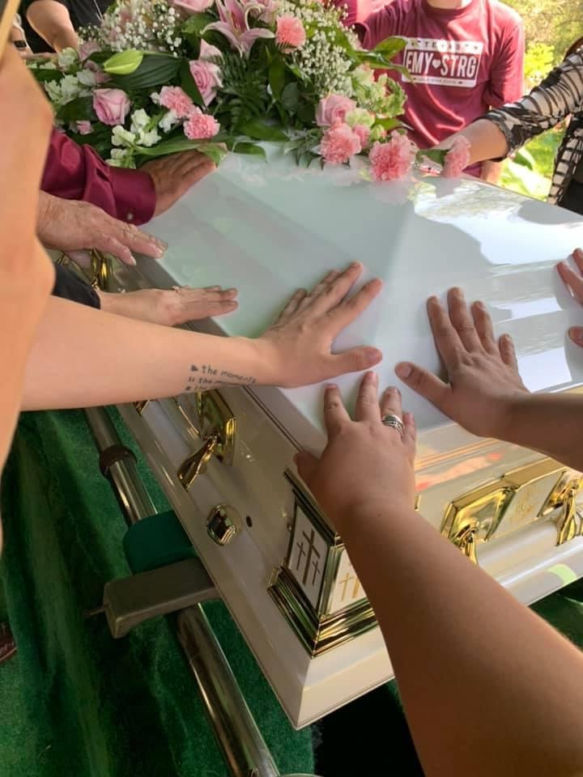
Emmy Saenz Foundation
Public Charity
Our passion is to give back to our community with our Wings of Hope Public Charity Program. When families experience a sudden, live changing event such as major illness, injury or even death and families need assistance with their benefit fundraising events, Emmy Saenz Foundation is here to give a hand to say YOU ARE NOT ALONE. Families are not always prepared for these sudden hardships. With the help of our generous donors and sponsors, we can keep this spirit of giving back alive. Losing a loved one is always hard on the heart, and we sympathize with families who struggle financially to prepare their loved one's funeral services. Donations are made directly to funeral homes through this Charity Program.

Slide 9
Sponsorship levels
Friends & Family
Bronze
Silver
Gold
Platinum

Slide 10
Friends & Family
Friends and Family Level is just that, a way for our Friends and Family to stay involved with Emmy Saenz Foundation through your contributions. You have the option to offer a one-time only donation, monthly donations or annual donation, whichever is most convenient for you.
Preferred donations for this level are $50 - $450, however, a more generous amount is greatly appreciated. Donations are tax deductible.

Slide 11
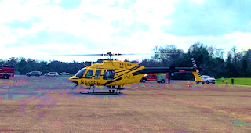
Bronze
Donation $500
Company Logo Banner (Company Provided) Advertisement at our Annual Fundraiser held at the Victoria Community Center Dome.
6 Tickets to the Event with a table reservation in the reserved seating area
Recognition at the beginning of the event by Emcee
Company Logo on Sponsor Banner displayed at entrance of Event.
** Company logos and pictures must be in high resolution jpeg files for printing capabilities for Sponsor Banner

Slide 12
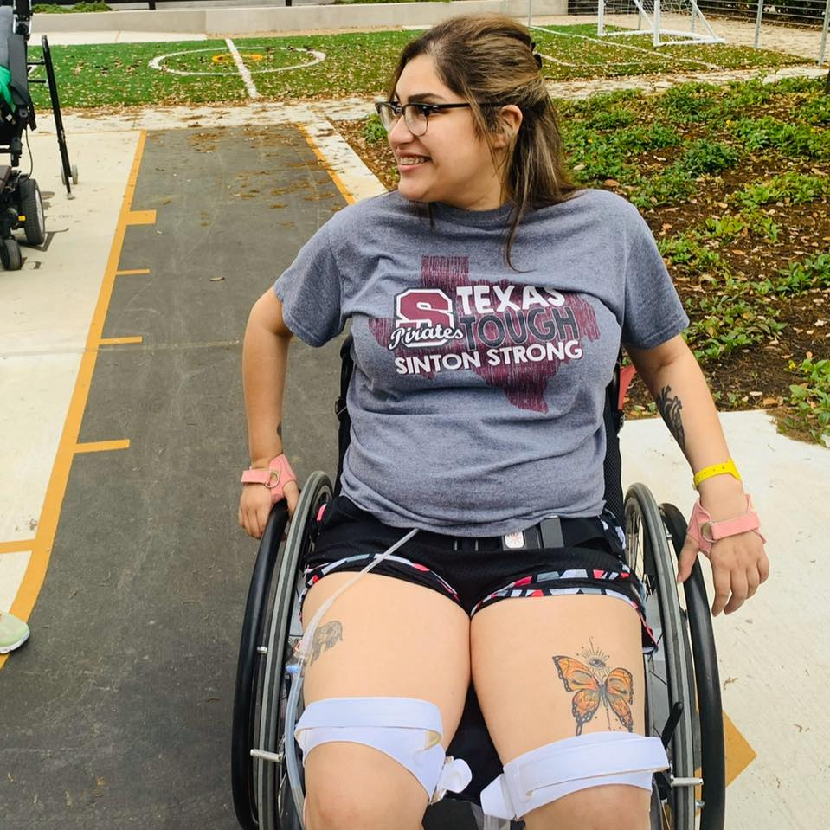
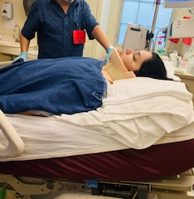
Silver
Donation of $1000
Company Logo Banner (Company Provided) advertisement at our Annual Fundraiser held at the Victoria Community Center Dome.
12 Tickets to the Event with a 2-table reservation in the reserved seating area
Recognition at the beginning of the event by Emcee
Advertisement on Emmy Saenz Foundation Website
Company Logo on Sponsor Banner displayed at entrance of Event
** Company logos and pictures must be in high resolution jpeg files for printing capabilities for Sponsorship Banner

Slide 13
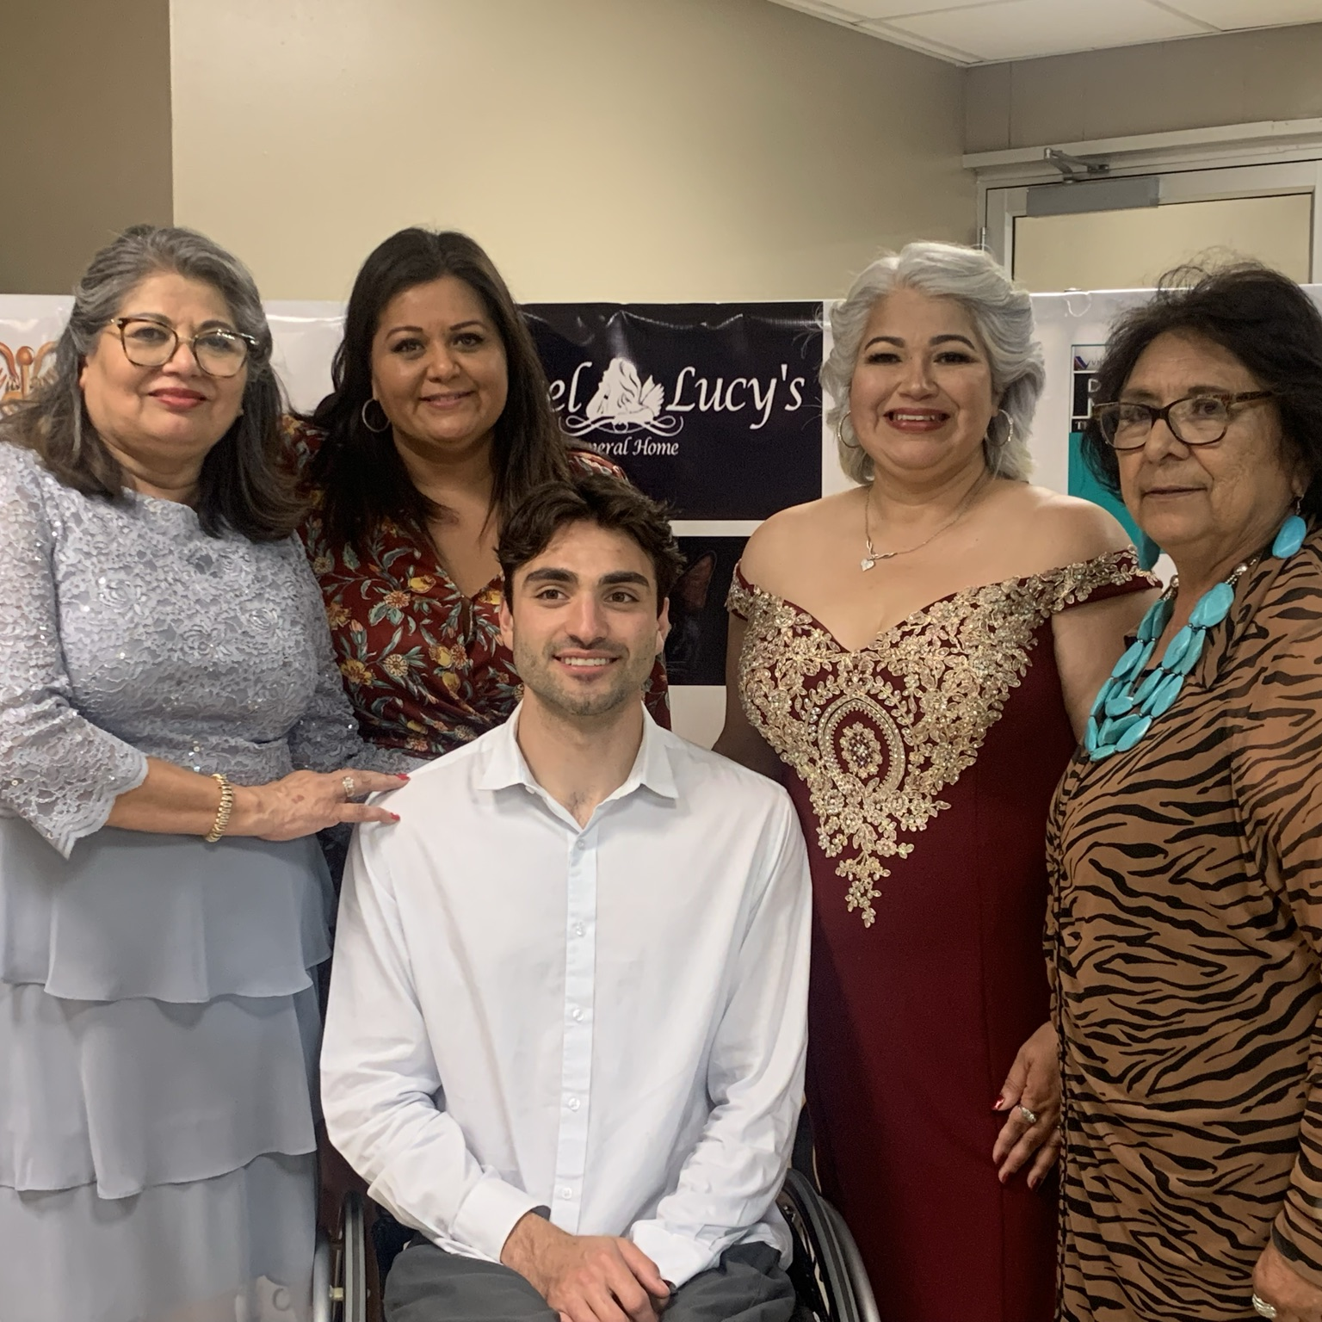
Gold
Donation $1500
Company Logo Banner (Company Provided) advertisement at our Annual Fundraiser held at the Victoria Community Center Dome.
12 Tickets to the Event with a 2-table reservation in the reserved seating area of Your Choice
Beverage Tickets and Appetizers
Recognition at the beginning of the event by Emcee
Advertisement on Emmy Saenz Foundation Website with link to your website option.
Company Logo on Sponsor Banner displayed at entrance of Event
** Company logos and pictures must be in high resolution jpeg files for printing capabilities for Sponsorship Banner

Slide 14
Platinum
Donation $2500 and Above
Company Logo advertisement at our Annual Fundraiser held at the Victoria Community Center Dome.
16 Tickets to the Event with a 3-table reservation in the reserved seating area Near Front and Center of Stage
Catered Meal Including Beverages
Recognition at the Beginning of the Event by Emcee
Introduction by your company representative to attendees at Event
Advertisement on Emmy Saenz Foundation Website with link to your website option
Opportunity to display marketing material and/or business cards at event and set up a booth
Company Logo on Sponsor Banner displayed at entrance of Event
** Company logos and pictures must be in high resolution jpeg files for printing capabilities for Sponsor Banner

Slide 15
Corporate Level
Donation $5000 and Above
Company Logo advertisement at our Annual Fundraiser held at the Victoria Community Center Dome.
24 Tickets to the Event with a 4-table reservation in the reserved seating area Front and Center of Stage
Catered Meal Including Beverages
Recognition at the Beginning of the Event by Emcee
Introduction by your company representative to attendees at Event
Advertisement on Emmy Saenz Foundation Website with link to your website option
Opportunity to display marketing material and/or business cards at event and set up a booth
Company Logo on Sponsor Banner displayed at entrance of Event
** Company logos and pictures must be in high resolution jpeg files for printing capabilities for Sponsor Banner

Slide 16
Sponsorship for annual Sportsman raffle
A sponsorship supporting our Annual Sportsman Raffle is also an option. There are 2 ways to Sponsor,
Monetary Donation to help cover raffle prize cost
2. Donate a prize for the raffle
With a Donation of $500 or Greater, you will receive the following:
Company Logo Banner Advertisement (Company Provided) at our Annual Fundraiser held at the Victoria Community Center Dome.
6 Tickets to the Event with a table reservation in the reserved seating area RSVP Required
Recognition at the beginning of the event by Emcee
Company Logo on Sponsor Banner displayed at entrance of Event.
** Company logos and pictures must be in high resolution jpeg files for printing capabilities for Sponsor Banner

Slide 17
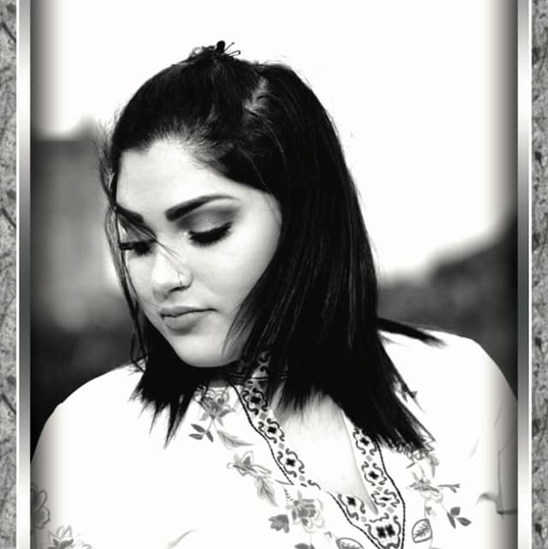
Emmy Saenz Foundation
Thank you for joining our efforts and becoming a proud Sponsor. Fill out the form below so we can contact you to complete this union of hearts and minds. Your Sponsorship will ensure we are able to fulfill the needs of our community through the programs we provide. Our 501(c)(3) Non-Profit Organization is fully funded by Donors like You! Your charitable contributions are tax-deductible. EIN# 86-1552435
Name: ______________________________________________________ Company:______________________________________________
Primary Phone:________________________________________________ Alternate Phone: _________________________________________
Address: _____________________________________________________________________________________________________________
Email:________________________________________________________________________________________________________________
Level of Sponsorship:_____________________________________________________________
Pledge: $_________________________ How often: ________________________

Slide 18
